Slide 1
Machine Learning Techniques Week III
Lecturer : Mr. Hel Chanthan
Student : Chek Nita

Slide 2
Planning
Week I
Introducing to Machine Learning
Done
Week II
Machine Learning Techniques
Done
Week III
Lab
In Progressing
Week IV
Own Project
In Progressing

Slide 3
Planning For October
October 2020 | Week I | Week II | Week III | Week III
Monday | Preparing & Researching Lab | Trying out some ML techniques | Figure out some formulars | Doing more Research
Tuesday | Preparing & Researching Lab | Preparing about researching | Use ML to test | Testing works
Wednesday | Done Research Lab | Practice code | Use ML to test | Complete works
Thursday | Presentation | Presentation | Presentation | Presentation
Friday | Research about Image Detection | Focus on main projects | Improving works | Review works
Saturday | Rewriting Code | Researching | Recoding | Make sure to Finish
Sunday | Practice | Collect Data | Research | Making Report

Slide 4
Outline
Regression
Recommender Systems
Classification

Slide 5
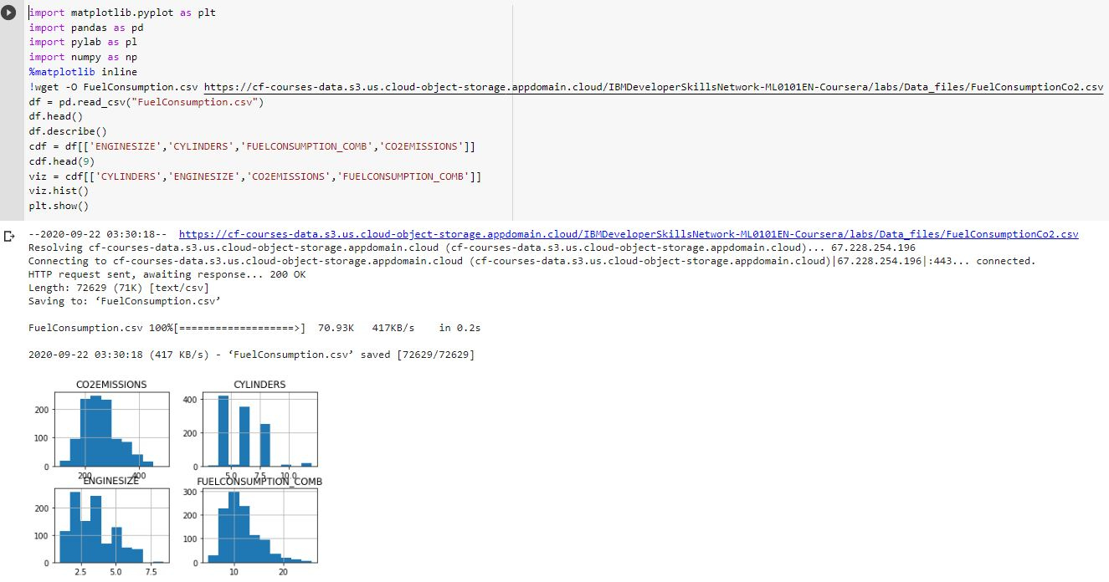
Regression

Slide 6
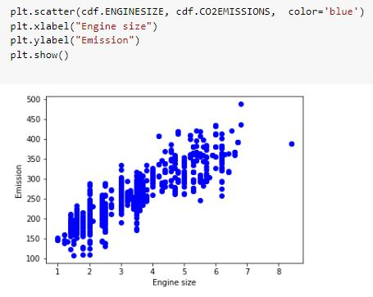
Linear Regression

Slide 7
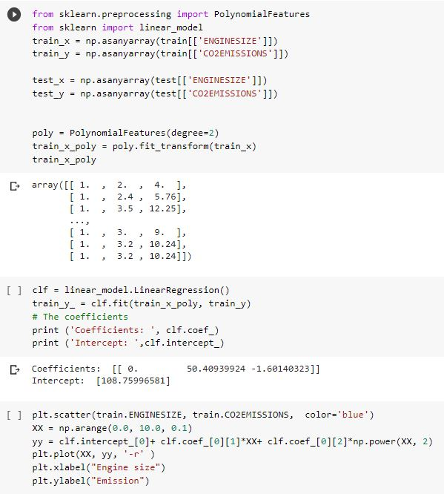
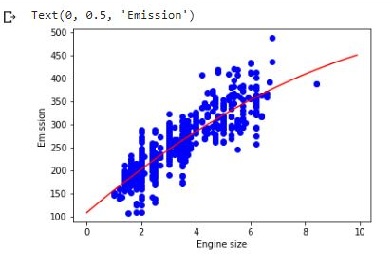
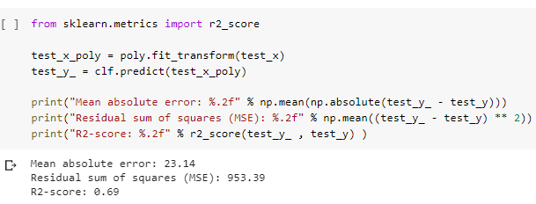
Linear Regression Training
Results

Slide 8
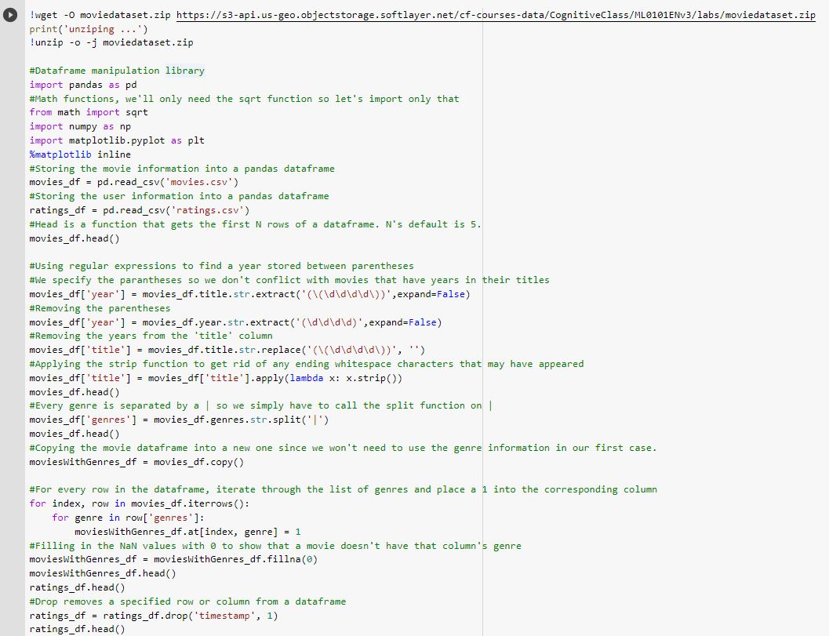
Recommender System

Slide 9
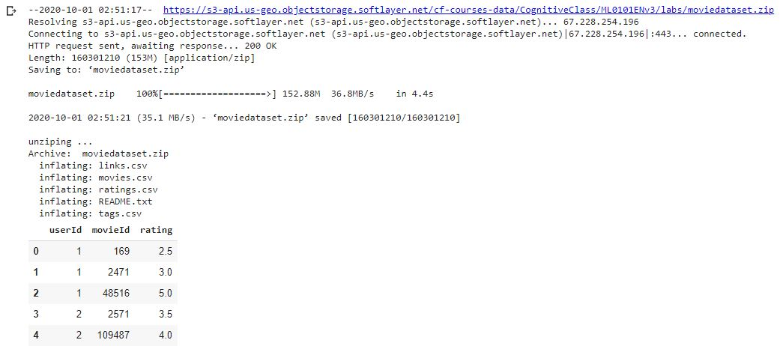
Recommender System
Results

Slide 10
Classification
Decision Tree : https://colab.research.google.com/drive/1NeZNFeN-gTuYNb0J-Eg4ruCYWnO3tCTm
SVM : https://colab.research.google.com/drive/1x4OjCxyf4NRs34w6iCunI39-rHCaOM4u#scrollTo=NMKheqDLWA7r

Slide 11
Thank You !!!

